Slide 1
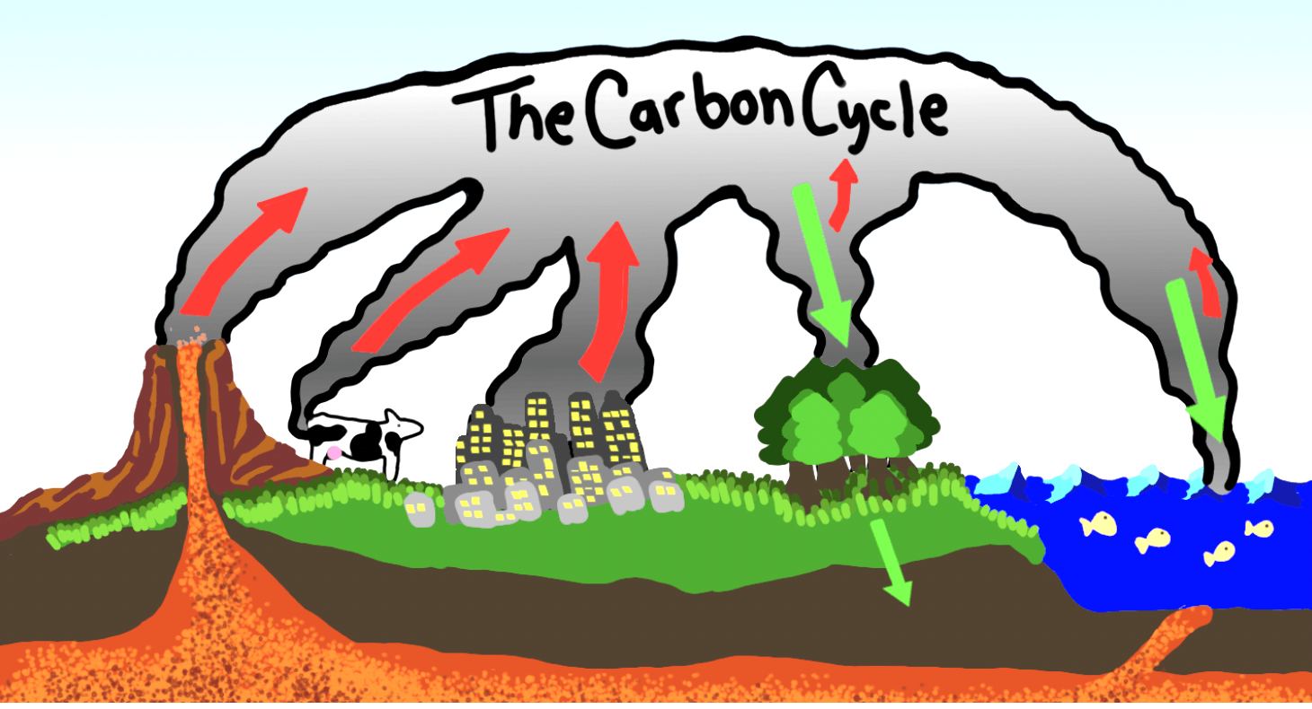
The Carbon Cycle and Photosynthesis
Life Science
Learning Goal: Examine the carbon cycle, investigate seasonal fluctuations in global CO₂ levels, and relate this to the process of photosynthesis.
Image source: By Sarah Morgan

Slide 2
Lesson Outline
Phenomenon: The Biosphere 2 experiment
Carbon Cycle: Short term cycle vs. long term cycle
  Short-term carbon cycle: photosynthesis and cellular respiration (model)
  Long term carbon cycle: Cycling of Carbon activity
3. Measuring CO₂ in the atmosphere
Observing patterns in: “Watching Earth Breathe”
4. Applying this lesson to the Initial Phenomenon (Biosphere 2 Experiment)

Slide 3
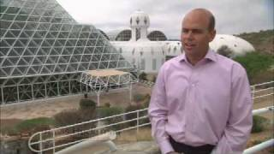
Phenomenon: The Biosphere 2 Experiment
Watch the video and answer the following questions:
Why was the project named "Biosphere 2" instead of "Biosphere 1"?
What would plants and animals need to survive in a closed space like Biosphere 2?
Notes:
Optional Slice

Slide 4
2. Carbon Cycle: Short term cycle vs. long term cycle
The short-term carbon cycle involves the rapid exchange of carbon dioxide (CO₂) between the atmosphere, land, and oceans through processes like photosynthesis and respiration. It regulates CO₂ levels on a relatively immediate timescale. In contrast, the long-term carbon cycle operates over geological timescales, involving processes such as rock weathering, volcanic activity, and the formation of fossil fuels. It regulates the long-term carbon balance on Earth, impacting climate change dynamics over centuries and beyond.

Slide 5
Short-Term Carbon Cycle: Photosynthesis and Cellular Respiration (model)
Photosynthesis: Photosynthesis is the process by which plants convert sunlight, carbon dioxide, and water into glucose and oxygen.
Using the handout, draw a preliminary model that represent photosynthesis.
Watch the video and refine your model.
Now watch this video and write a paragraph explaining how to relate photosynthesis with cellular respiration.
Summary: The short-term carbon cycle involves the exchange of CO₂ between the atmosphere, land, and oceans through processes like photosynthesis and cellular respiration.

Slide 6
Long Term Carbon Cycle: Cycling of Carbon activity
Using PBS Learning: Carbon Dioxide and the Carbon Cycle
Follow this link to open an interactive carbon cycle model. Complete the table below about Carbon Cycle Reservoirs by clicking on the each blue tab
 | How many gigatons of carbon are in this reservoir? | Explain what this reservoir is.
Fossil fuel
Ocean
Atmosphere
Land Biomass
Rocks

Slide 7
Access the interactive model and navigate to the "CO2 and the Atmosphere" tab.
  Observe the image and the accompanying information it contains. Then, select the "Present Day" option to explore the updated information. Describe the differences between 300 years ago and today according to the image.
  After selecting the "View Chart" option on the right-hand side, you can see that three centuries ago the inflow of CO2 into the atmosphere was balanced by the outflow of CO2 from the atmosphere. Now, click “Present Day” and review the information on the chart. Answer the following questions:
    How many gigatons of CO₂ go into the atmosphere from human activity annually?
    How many gigatons does CO2 increase in the atmosphere each year?

Slide 8
3. Measuring CO₂ in the atmosphere
Why is it important to measure CO₂?
Measuring CO₂ in the atmosphere is vital to comprehend climate change, evaluate human impacts, guide mitigation strategies, predict climate patterns, and understand its role in photosynthesis and ecosystem dynamics.
How can we measure and monitor CO₂ in the atmosphere?
CO₂ in the atmosphere can be measured using various methods such as gas analyzers, satellite observations, and air sampling. Also, it can be monitored by using greenhouse gas (GHG) sensors which provides crucial insights into environmental conditions, helping to understand climate change dynamics and inform decision-making for mitigation efforts and air quality management.

Slide 9
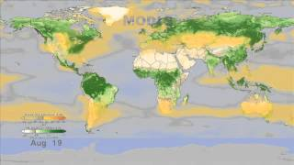
Observing Patterns in: “Watching Earth Breathe”
As you watch the video, you will answer the following questions:
In this video, how does NASA measure CO₂ concentrations?
In general, which hemisphere experiences a greater change in CO₂ levels throughout the year: the Northern or Southern hemispheres?
Is the video of watching Earth breathe related to the short-term carbon cycle or long-term carbon cycle?
Explain the patterns you observe in the video as they relate to CO₂ and photosynthesis.

Slide 10
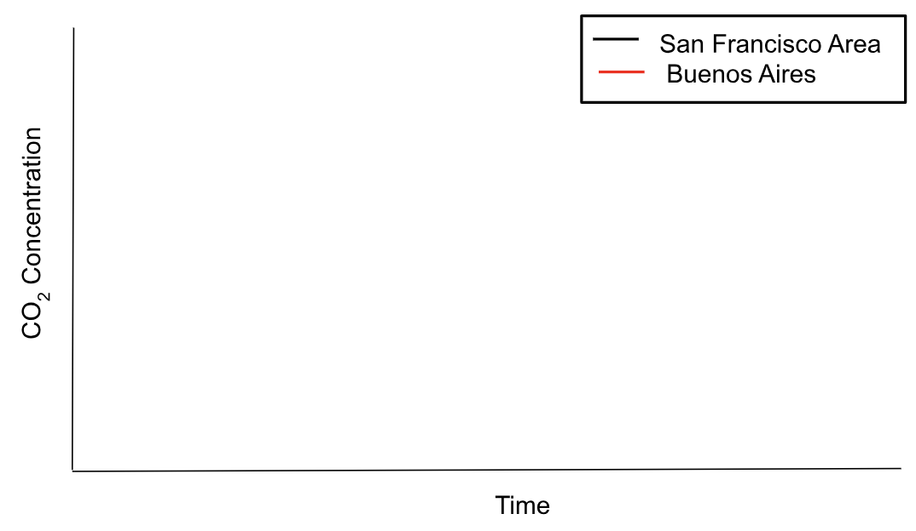
4. Applying this lesson to the Initial Phenomenon (Biosphere 2 Experiment)
Use what you have learned to improve your response from Page 1 Q2 on the handout: What would plants and animals need to survive in a closed space like Biosphere 2?
Is Biosphere 2 an example of a short-term or long-term carbon cycle?
Look at your multiyear CO2 time-series plot that you created in the Exploration Google Colab notebook (pasted in the Handout as well). This plot is for California. In the graph below, sketch the curve that you’d expect if you were monitoring CO2 in Buenos Aires (and include estimate x and y values).

